Slide 1
Numerical methods for differential equations
1. Ordinary Differential Equations (ODE)
Sebastien CHARNOZ & Andrea CIARDI
Paris Physics Master
Université Paris Cité / Sorbonne Université

Slide 2
1. Classification of differential equations
Dynamical systems
The evolution of dynamical systems are governed by Differential equations
Fall of a body:
Planetary motion:
Heat transfer :
Wave Equation etc ...:
Etc ...

Slide 3
Depending on the system, there are always
One or more quantities must be determined
That depend on on one or more parameters
X, V, V
temperature T
The time t
Time t, x space

Slide 4
There are always boundary conditions (or initial conditions)
Falling bodies, planetary motion:
initial positions and velocities
Heat Transfer:
boundary condition initial temperature (spatial distribution)
wave equation:
boundary condition (a rope, for example)
Initial state of the rope

Slide 5
« Solving the problem » consists in
CALCULATING THE EVOLUTION OF QUANTITIES AS A FUNCTION OF PARAMETERS
For example :
For planets: X (t) and V (t) : position and velocity as a function of time
For heat: T (x, t) : Temperature as a function of space and time
In other words: solve the differential equation ( "integrate")

Slide 6
A list of quantities that evolve according a list of parameters
A differiential equations linking all quantities to all parameters. As many as. diff equations as
quantities.
a set of initial, or boundary, conditions
A problem is well-posed if we have
EXAMPLES

Slide 7
Wave propagation
Parameters: X (position) and T (time)
Quantity: U (x, t): Amplitude at position X and at time t
equation:
forcing
Initial condition problem Depends of course,
profile u (x) at t = 0
http://micromachine.stanford.edu/~hopcroft/Research/resonator_images/sin_mov1.gif

Slide 8
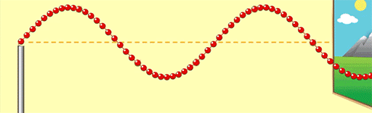

Slide 9
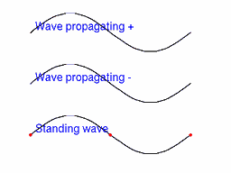

Slide 10
Planetary motion
Quantities: position and velocity: (X, Y, Z, Vx, Vy, Vz)
Parameter: Time
Differential equations
6 in total
Same pout Y and Z
Initial conditions: Initial Position and speed
https://thumbs.gfycat.com/EnchantingPositiveGermanshepherd-mobile.mp4

Slide 11
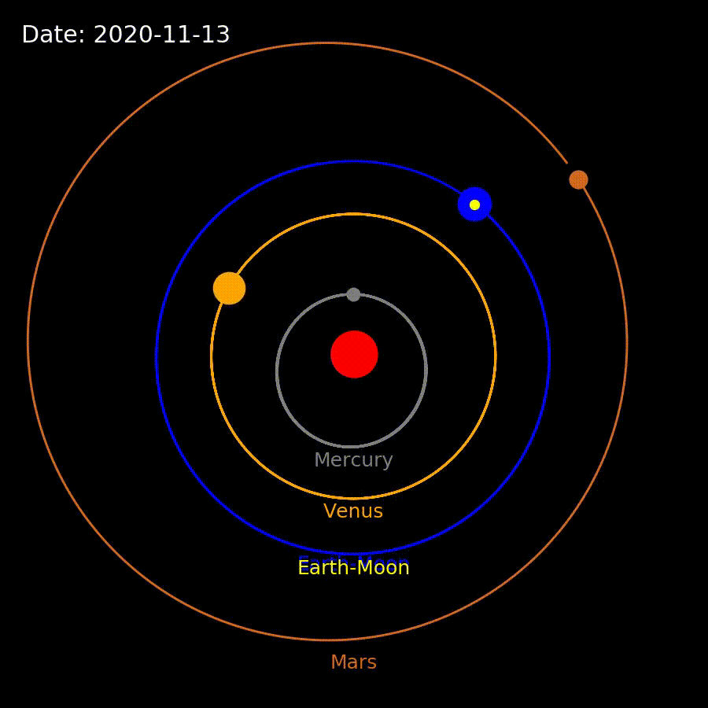

Slide 12
Propagation of heat
Quantity: temperature T
Parameter: X (space) and t (time)
equation:
forcage
Initial condition: Profile T (x) at t = 0
https://upload.wikimedia.org/wikipedia/commons/f/f7/Heat_Transfer.gif

Slide 13
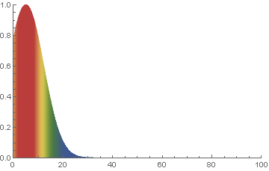

Slide 14
RESOLUTION: THE METHODS

Slide 15
All methods are based on the same idea coming from the limits imposed by the computer :
Discretization of the problem
The parameters are discretized :
example:
If time is a parameter then :
time is written t(n) = t_{n} = N * dt where dt is the time step
If space is a parameter then :
Then position : x(n)=x_{n} = n * dx where dx will be the space step

Slide 16
So we solve the problem on a grid (for the PARAMETERS, not the quantities)
A time grid, a space grid etc ...
The smaller the step (dt or dx) the closer the numeric solution will be to the exact solution
1D (time, space etc ... 1D) t_{not}Dt = nx
0 1 2 3 4 5 6 ....
dt
If 1D (1 single parameter, eg time)
The resolution consist in calculating a Serie :
U_{n + 1}= S (U_{n}, t_{n})
That means : Solution at next step = S(solution at previous step)
The big question is: WHAT IS F ?? S is « the solver »

Slide 17
Time Grid
0 1 2 3 4 5 6 ....
dt
Space Grid
In 2D or more
ex:
In fact we make a 3D grid (2D space + time 1D)
U_{i, j, k}= S (neighboring cells)

Slide 18
For now
we are only interested by Ordinary Diferential Equations:
ODE
Differential equations that dependi only on ONE parameter !
(only one parameter at the denominator of the derivative)

Slide 19
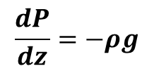
Example ODEs:
Why ? Because only
One parameter (t or z)
$$\frac{dP}{dz}=−ρg$$
BUT
These are NOT ODEs (they are PDE in fact):
Why ? Because > 1 parameter (2 in fact)

Slide 20
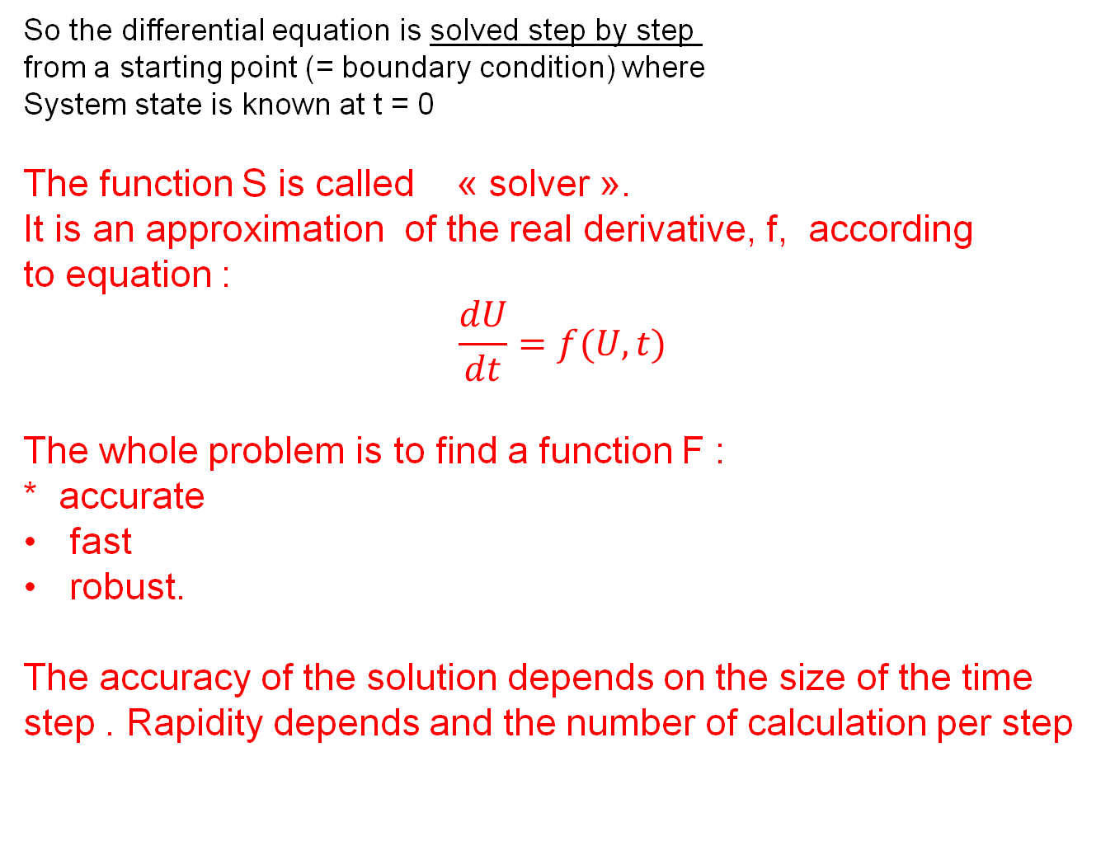
For ODE we write the following
U_{n + 1}= S (U_{n}, t_{n})
So the differential equation is solved step by step from a starting point (= boundary condition) where
System state is known at t = 0
The function S is called « solver ». It is an approximation of the real derivative, f, according to equation :
$$\frac{dU}{dt}=f(U,t)$$
The whole problem is to find a function F : * accurate
fast
robust.
The accuracy of the solution depends on the size of the time step . Rapidity depends and the number of calculation per step

Slide 21
2. Example of numerical resolution

Slide 22
1 Movement of a spring: A simple ODE
Quantities X and Vx
Parameter: t
Equations:
k: coefficient. Spring stiffness m: mass
x
Do we need something more ?

Slide 23
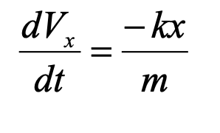
YES! because we lack the X evolution equation:
In the above equation, x appears on th RHS but its evolution is not given.
So we need an additional equation for x
So the full set of
Equations is :
A n^{th} order ODE (n=2 for newtonian mechanics) can be always be transformed into
a system of n first order equations !!

Slide 24
Then:
Quantities X and Vx
Parameter t
Equations :
k: coefficient. stiffness m: mass
Initial conditions : X (t = 0) = 10 m
V (t = 0) = 0. m / s
ANALYTICAL SOLUTION: * demonstrate
ω = sqrt (k / m), A = X0

Slide 25
We now solve the SAME problem
But numerically integrating the equation.
We need an algorithm to calculate the evolution
Of the solution with small time increments dt.
We will discover the "problems" of numerical integration

Slide 26
Take a grid for the parameter t with dt = 0.01 seconds
X_{n + 1} = S (X_{n}, V_{n,} T_{n}) V_{n + 1} = S (V_{n}, V_{n,} T_{n}), where t_{n} = N * dt
S is the « solver ». We will apply here the method of Euler (we'll see)
ALGORITHM
1. Initialize X₀ and V₀ 2. Initialize dt 3. Calculate X_{n + 1} = F (X_{n}, V_{n,} T_{n}) and V_{n + 1} = F (Vn, tn) 4. Increment time T = T + dt 5. Go 3.

Slide 27
2. Construction of a solver: basic methods
An ordinary differential equation can always be written as a set of differential equations of the first order
quantities
Parameter (single)

Slide 28
Vector Writing
Example: the spring (calculate *)
Note: Here the derivative does not explicitely depend on time t, because the force does not depend explicitly time
F_{x}= V and F_{v}= -Kx / m

Slide 29
Vector Writing
Example: the spring (calculate *)
Note: Here the derivative does not explicitely depend on time t, because the force does not depend explicitly time
F_{x}= V and F_{v}= -Kx / m

Slide 30
Real equation:
function f
Numerical approximation
X_{n + 1}= X at time t_{n + 1} where t_{n + 1} = (N + 1) x dt
f is the derivative, F is the solver
function F

Slide 31
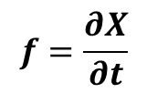
The Euler Method
The basic tool for building F(MAIN PARAMETER) is the Taylor expansion:
$$f=\frac{∂X}{∂t}$$
In practice we only know f. The goal of any solver is to estimate the best possible développent of X knowing only f...
It's possible !

Slide 32
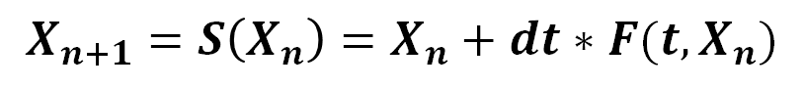
Using the development of taylor :
Ignored terms
Function, Equa. diff system
Inspired by this development, the function F will be:
Where F is a numerical approximation the derivative !!
$$X_{n+1}=S\left(X_{n}\right)=X_{n}+dt∗F(t,X_{n})$$

Slide 33
How to build S:
The simplest case is the Euler Method:
Euler Method :
For Euler we just set F (x, t) = f (x, t)
The function S (x, t) is then: X_{n+1} =S(X_{n})= X_{n} + F (x, t) dt
Example: Spring Case with Euler

Slide 34
The Euler scheme is the simplest possible.
It is a 1-order solver (as between t and t + dt the ERROR is o (dt¹)
It's a quick scheme because there is only ONE call to the derivative f
In practice: never used
But we can do much better!

Slide 35
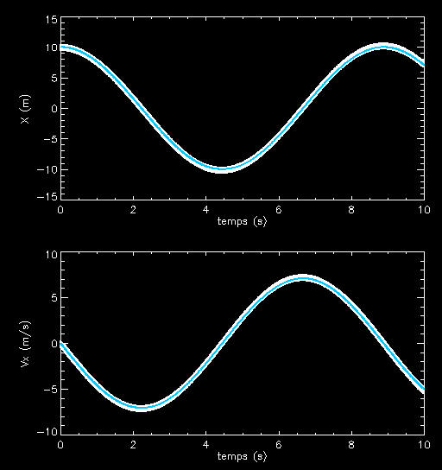
numerical solution: spring solved by Euler
dt = 0.01 s
N t XV
0.000000 0.000000 0.000000 10.0000
1.00000 0.0100000 10.0000 -0.0500000
2.00000 0.0200000 9.99950 -0.100000
3.00000 0.0300000 9.99850 -0.149998
4.00000 0.0400000 9.99700 -0.199990
5.00000 0.0500000 9.99500 -0.249975
6.00000 0.0600000 9.99250 -0.299950
7.00000 0.0700000 9.98950 -0.349912
8.00000 0.0800000 9.98600 -0.399860
9.00000 0.0900000 9.98200 -0.449790
10.0000 0.100000 9.97751 -0.499700
11.0000 0.110000 9.97251 -0.549588
12.0000 0.120000 9.96701 -0.599450
13.0000 0.130000 9.96102 -0.649285
14.0000 0.140000 9.95452 -0.699090
15.0000 0.150000 9.94753 -0.748863
16.0000 0.160000 9.94005 -0.798601
17.0000 0.170000 9.93206 -0.848301
18.0000 0.180000 9.92358 -0.897961
19.0000 0.190000 9.91460 -0.947579
20.0000 0.200000 9.90512 -0.997152
21.0000 0.210000 9.89515 -1.04668
22.0000 0.220000 9.88468 -1.09615
23.0000 0.230000 9.87372 -1.14558
24.0000 0.240000 9.86227 -1.19495
25.0000 0.250000 9.85032 -1.24426
26.0000 0.260000 9.83787 -1.29351
27.0000 0.270000 9.82494 -1.34270
28.0000 0.280000 9.81151 -1.39182
29.0000 0.290000 9.79760 -1.44088
etc ..
White: Digita : numerical solution blue: Analytical true solution

Slide 36
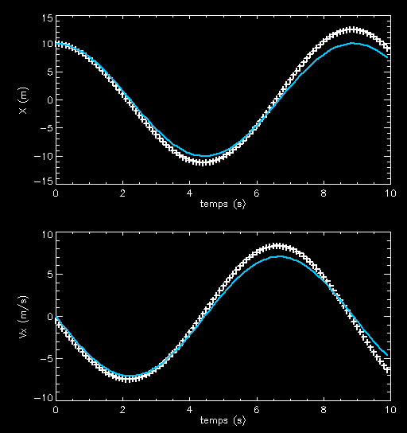
But the numerical solution depends of the time-step
dt = 0.1 s
The bigger dt, the larger the error

Slide 37
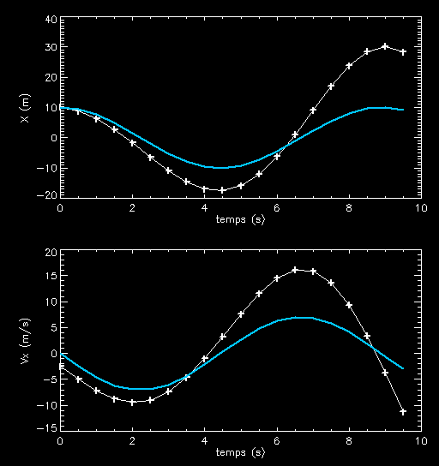
dt = 0.5 s
FOR ANY SOLVER:
Any numerical solution is only approximate
The accuracy depends on the time-step of integration
For larger dt: computing is faster BUT is less accurate
And vice versa ...

Slide 38
The accuracy decreases as the number of stages of calculations:
Dt = 0.01 s
1000 calculation steps
Looks good !

Slide 39
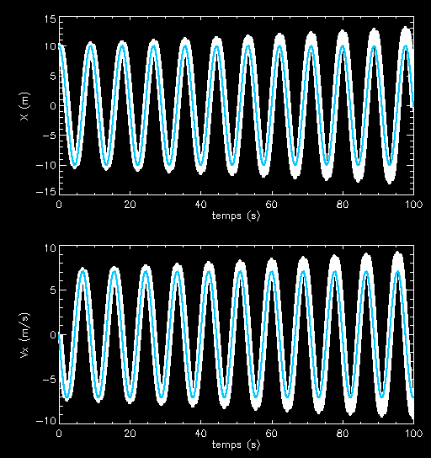
Dt = 0.01 s
10000 steps
still good !

Slide 40
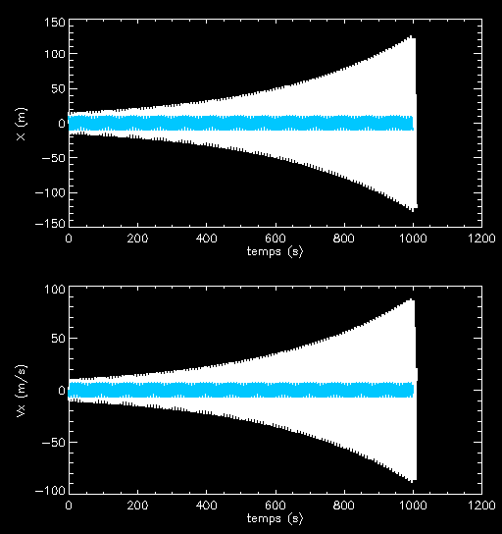
Dt = 0.01s
100000 steps
not good !
All solutions ends by shifting away from the solution when the number of steps calculation increases
=> Accumulation of errors

Slide 41
How to build a solver?
- Accurate - Stable
- fast

Slide 42
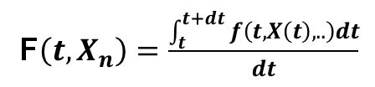
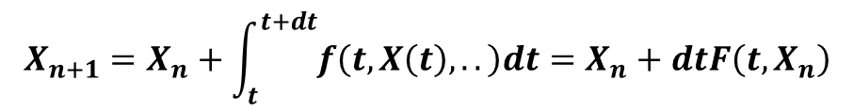
Build a better approximation, by considering integration, rather than taylor
Expansion
It is known that correct X_{n + 1} is :
$$X_{n+1}={X_{n}+\int_{t}^{t+dt}{f\left(t,X\left(t\right),..\right)dt}=X}_{n}+dtF\left(t,X_{n}\right)$$
therefore
F$\left(t,X_{n}\right)=\frac{\int_{t}^{t+dt}{f\left(t,X\left(t\right),..\right)dt}}{dt}$
F is the area under the curve divided by dt
Or
F is the mean value of f(x,t) within interval [t,t+dt]
f
t

Slide 43
Idea: F approximated by the trapezoidal method, midpoint method
dt / 2
Euler
f
t
t_{n}
t_{n + 1}
dt
F ~ (blue area) / dt

Slide 44
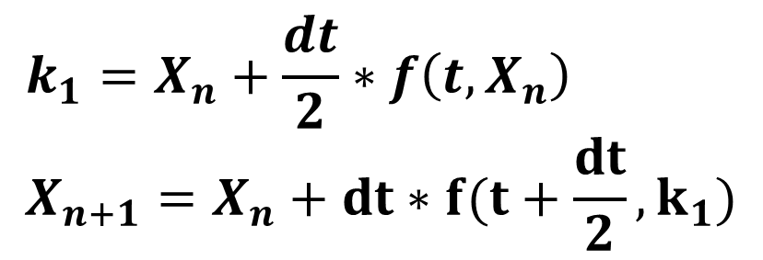
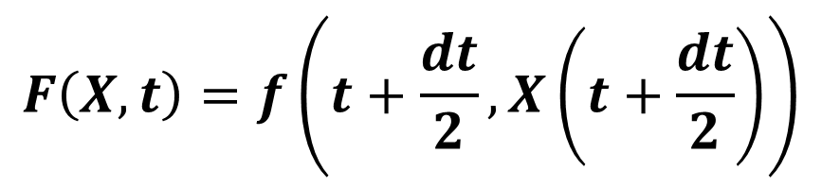
Implementation
$$F\left(X,t\right)=f\left(t+\frac{dt}{2}, X\left(t+\frac{dt}{2}\right)\right)$$
How do we know X (t + dt / 2) ?
Use taylor expansion
then obtained a new integration scheme: Modified Euler modified
Algorithm
$$k_{1}=X_{n}+\frac{dt}{2}∗f\left(t,X_{n}\right) \\ X_{n+1}=X_{n}+dt∗f(t+\frac{dt}{2},k_{1})$$

Slide 45
Modifid Euler is a more accurate solver than simple Euler!!
Show that a modified Euler solver is order 2.
Below we only consider time t dependence
The scheme is:

Slide 46
We therefore get
But the real development of X Taylor_{not} is (knowing that dX / dt = f)
The method of modified Euler is accurate up to order 2 (it fails at the 3rd order)

Slide 47
Difference between 2 steps of "Euler" and 1 step of "Euler Modified"
integrate:
Euler
Euler modified
2 steps of length dt / 2
1 step of length dt
from 0 to dt / 2
We restart at dt
But take the derivative at point dt/2
Step 1 is time dt
Step 2 is time dt

Slide 48
example:
Integrate with dt = 0.1
Euler
Modified Euler
2 steps dt / 2
1 step dt
Euler: U (t = 0.1) = 0.7225
Euler modified :
U (t = 0.1) = 0.740818

Slide 49
In this simple case, we have an analytical solution
To which we can compare our result
U (t = 0.1) = 0.740818
Real result
Euler: U (t = 0.1) = 0.7225
Euler modified
U (t = 0.1) = 0.740818

Slide 50
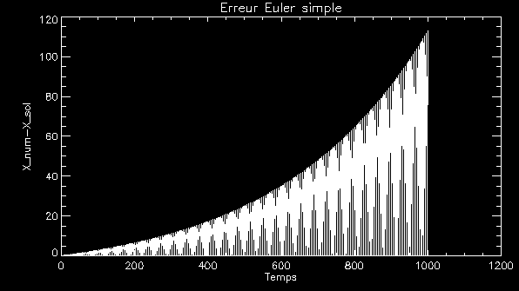
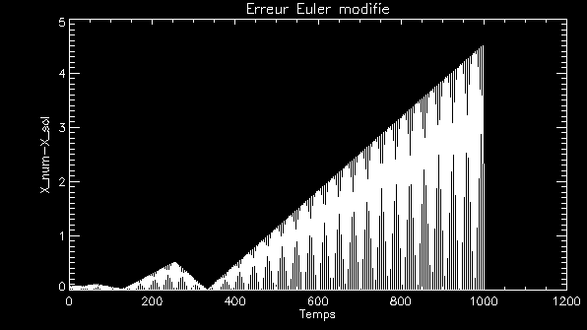
Example with same timestep
Example of the spring
Abs (X_vrai-X_approx)
Euler :
Dt = 0.01
Euler modified:
Precision Gain:
A factor 20 !!

Slide 51
Euler and Modified Euler are the two simplest solvers
BUT
Many other solvers exist for ODE

Slide 52
Catalogue of ODE most common solvers.
The order of the solver is in parenthesis
explicit Euler (1)
Euler implicit (1)
Leap Frog (2)
Euler modified (2)
Cranck Nicholson (2) implicit
Adam Bashfort (2)
Adam Bashfort (3)
Adam Moulton (3)

Slide 53
K1 = angular term of the straight line in 1st point
k2 = angular term in the second point
Runge Kutta (2)
Runge Kutta (4)

Slide 54
A "popular" explicit solver: the Runge Kutta 4 (RK4)
Easy to implement, "Relatively" stable ..
Quite "slow" because 4 calls to the derivative.

Slide 55
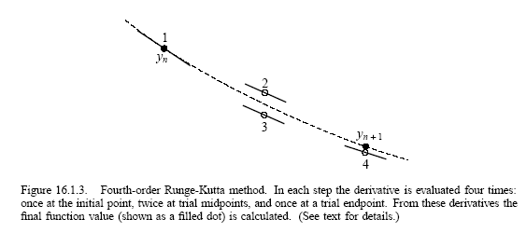
Principle
RK4:
4 evaluations in of the time
order 4

Slide 56
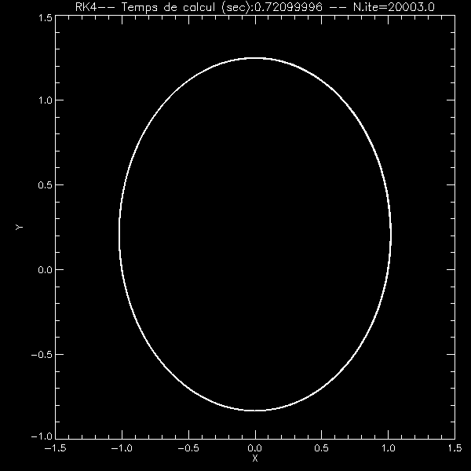
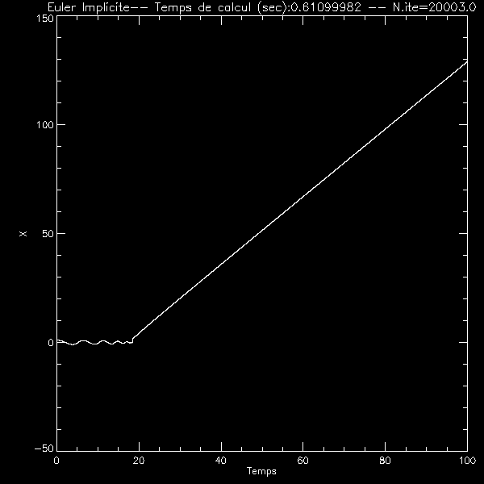
Consider a complicated system:
The motion of a planet around the Sun:
A = - GM u / r ^ 2
Dt = 0.1, Dynamic Time = 2PI
RK4
Everything goes well priori
Implicit Euler

Slide 57
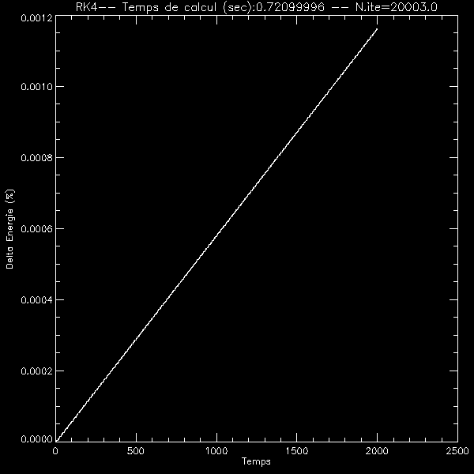
A simple control parameter: Energy
The total energy should be kept: E = 1/2 mV² -Gm / r
dt = 0.1
1 orbit = 2PI
Energy artificially increased from 0.12% in 250 orbits (250 dynamic time)
We believe the result will Beyond 250000 orbits
(1000 times) because
ΔE ~ E after this time

Slide 58
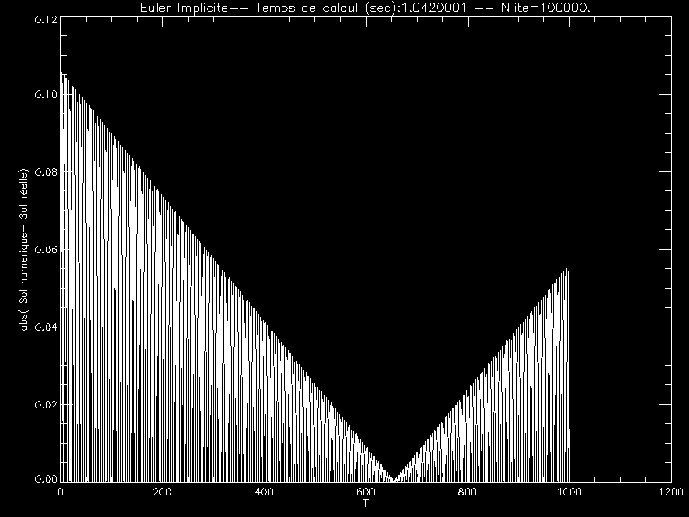
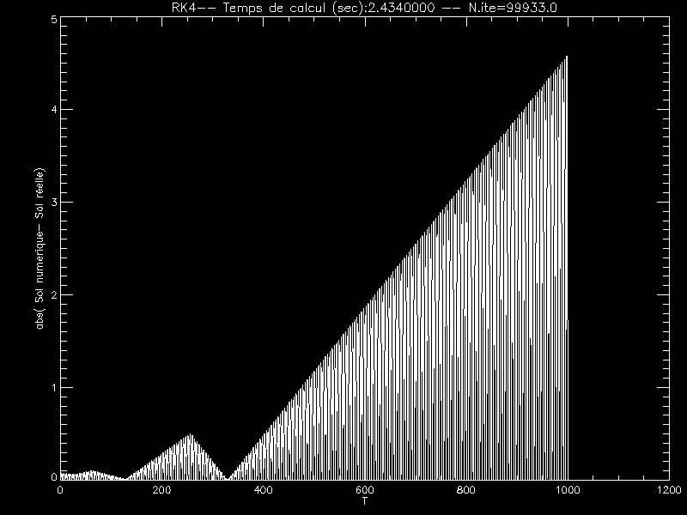
Is The Runge Kutta more accurate than Euler implicit?
In principle yes, but not always !!! example: spring
Implicit Euler
RK4
The RK4 is worse
In fact the implicit equation is better suited to for the spring
Fewer calls to the derivative
less rounding errors

Slide 59
IMPLICIT SOLVERS
The schemes we have seen are called explicit solvers :
Euler: X_{n + 1}= X_{n} + dt f (tn, X_{n})
Euler modified: X_{n + 1} = X_{n} + dt f (t + dt / 2, f (X_{n} + dt / 2))
because X_{n + 1} only DEPENDS on the previous indices (n, n-1, etc ..). It s calculated directly.
ANOTHER family of solvers are the
« implicit solvers » :

Slide 60
Example: Cranck Nicolson
X_{n + 1} depends on X_{n + 1} and X_{n}
It is necessary to solve a nonlinear equation to determine X_{n + 1} .
Not straigthforward ! => implicit scheme.
Implicit solvers are often less accurate
'' '' '' '' '' '' '' '' '' '' ’’are more complicated to use and modify
BUT
They are more stable than the explicit solvers: they diverge less quickly.
In other words: less accurate in the short term, more accurate on then long-term

Slide 61
Parctical example EULER implicit
Schemes:
equation to
resolve:
Writing the implicit algorithm:

Slide 62
This is solved by substitution

Slide 63
Stability of a solver
For a given solver, it is important to quantify its stability, in other words its conditions of divergence
What is the "stability"?
MOST solvers go away from the real solution.
The question is: what is the "sensitivity" of the computational schemes? How fast does it diverge ?
or
How fast are small errors amplified by the scheme ?

Slide 64
Let’s consider this scheme : X_{n + 1}= X_{n}+ dt F (t_{n}X_{n})
To quantify the stability, we=> implicit scheme.
assume that X is adjacent to a stationary point Xs
We quantify the the rate at which the scheme goes away from the solution.
X
X_{s}
t

Slide 65
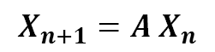
EXAMPLE spring uwing Euler exoplicit method (Intrinsically linear method) :
We use matrix notation for systems of ODEs
$$X_{n+1}=A X_{n}$$

Slide 66
Let e_{n + 1}= X_{n + 1}-X_{n} the error in the solution. We assume e_{n}<< X_{n}
Will the numerical scheme will amplify or damp the error ?
A Is the amplification matrix
Stability conditions? Looking at the eigenvalues ​​of A

Slide 67
Matrix notation. Example with a system with three variables: X, Y and Z. Let ex, ey and ez errors in X, Y and Z
If A is diagonalizable A = M⁻¹ D M, where M is the transition matrix and the diagonal matrix D containing eigen values
Vectors in the eigen base A

Slide 68
In the eigen base
So for STABILITY (⬄ no amplification of error)
all the eigenvalues ​​of the amplification matrix A must be <1 in absolute value.
Let V = MAX [abs (v1), abs (v2), abs (v3)]. V depends of the time dt
If V <1 dt <dt_{max} then the scheme is conditionally stable
if V _{i} <1 for all dt, then the scheme is unconditionally stable
if V _{i}> 1 for all dt, then the schema is unconditionally unstable

Slide 69
Example with the spring + Euler method
Form: X_{n + 1}= AX_{not}
Amplification matrix A

Slide 70
λ Eigen values : solution of characteristic polynomial λ²- trace(A )x λ + determinant = 0 =>
The two eigenvalues are always smaller than (in norm):
>1
So Euler scheme, applied to sprin equation is unconditionally unstable (dt> 0)

Slide 71
Example with the spring + implicit Euler method
Substitution
Matrix amplification
Form: X_{n + 1}= AX_{not}

Slide 72
Calculating the amplification A matric
(A such that X_{n + 1}= AX_{not)}

Slide 73
The eigen values ​​are:
(Where we use identity : a²+ b²= (a + ib) (a-ib))
Eigen values norm are:
They are always <1
With the problem of the spring, Euler Implicit scheme : unconditionally stabe

Slide 74
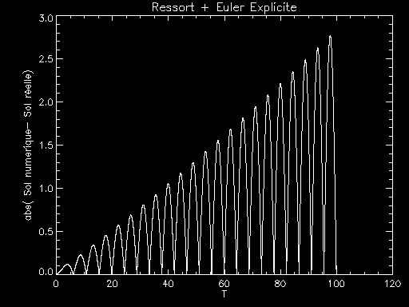
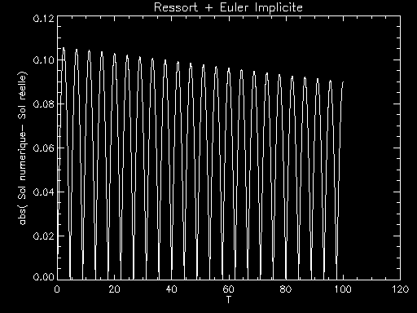
Compare Euler Explicit vs Implicit: Spring Case
error Explicit
Dt = 0.01
10000 iterations
Implicit error

Slide 75
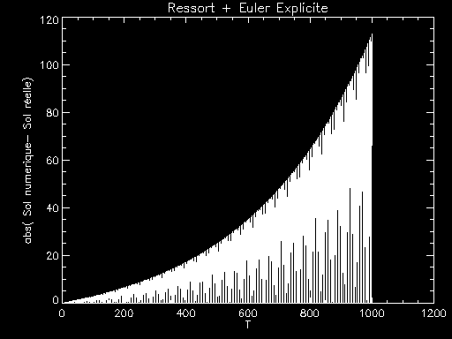
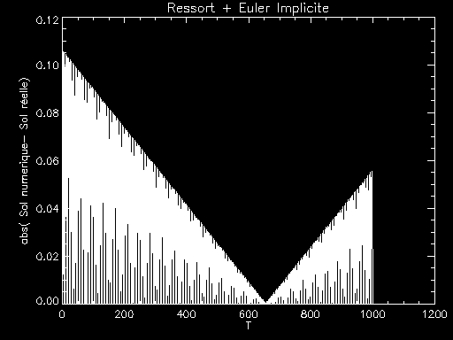
error Explicit
Dt = 0.01
100000 iterations
Implicit error

Slide 76
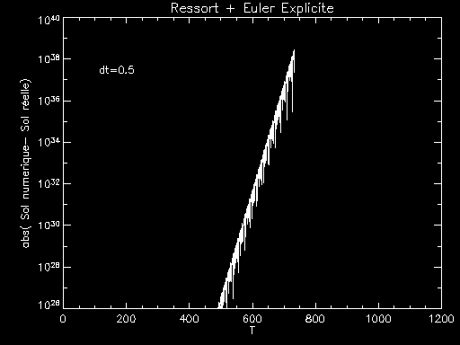
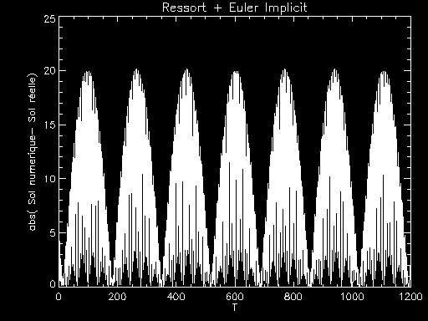
Large time step: dt = 0.5 (instead of 0.01)
Error for Explicit Euler
.... The solution diverges...
100000 iterations
Implicit Euler Error
The error does not diverge
... but the result is still wrong

Slide 77
The implicit solver is somewhat less accurate at the beginning of integration
BUT
In the long term, it does not diverge like crazy, eventhough the solution might be wrong..
THEREFORE
When stability is important, it is intereting to use an implicit solver

Slide 78
What solver choose?
Trade-off between the computation time, desired accuracy and stability
low-order (1,2) explicit
Fast, very unstable, very precise on short term
low-order (1,2) implicit
Moderately fast, very stable, may be more accurate on long term, than on short term
high order (3.4 +) Explicit
Slow, steady, accurate enough for most application (but not always…)
high order (3,4, +) Implicit
Very slow, very stable, very accurate BUT ... almost never used.

Slide 79
What time step to choose?
General rule: dt << all dynamical timescales of the system
It is necessary to always thoroughly test the time step ! by controlling certain parameters.
(Typical example: use energy, angular momentum, any quantity that should be preserved, like integrals of motions)

Slide 80
example:
For the spring, the characteristic time is the oscillation period,
So we should take dt << T
In our example: m = 1, k = 1 => T = 6.28 seconds.
With dt = 0.01 s OK
With dt = 0.5s PB !! (See above figures)

Slide 81
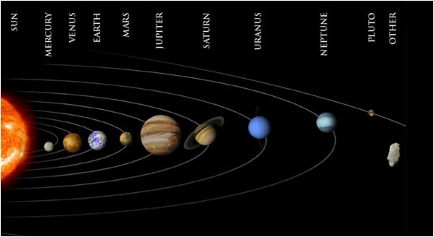
What to do when there are many different timescales in a problem?
« STIFF problems »
=> We are constrained by the smallest time-scale....
Example: The Solar System:
Orbital Period
Mercury: 88 days
Earth: 1 year
Jupiter: 12 years
Pluto: 248 years
ALL the planets interact (coupling)
In this system, it has a factor of 1000 between the shortest time dynamic and the longest ...
What to choose for dt ??
We have no choice: dt << 88 weeks ...
Conclusion The majority of computing time just serves to integrate Mercury

Slide 82
A bad idea :
Integrate planet motion with different time step for each planet
The result will invariably false because different variables the systems will not be SYNCHRONIZED !!
For example:
Mercury dt, 2dt, 3dt, 4 dt, 5 dt, dt 6, 7 dt, dt 8, 9 10 dt dt
Earth 2dt 4dT 6dT 8 dt 10 dt
Jupiter 3dt 6dT 9dT
Plunto: 5dT 10dT
PB: For Mercury we need to know ALL the position planets to each value of dt ...

Slide 83
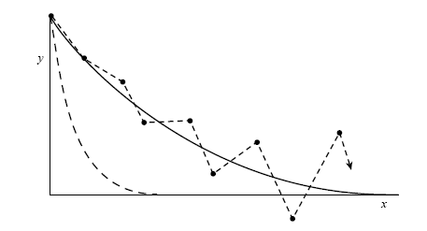
Another example: A system with two variables
With U (0) = 1, V (0) = 0
Two time scales: 1 and 1/1000
An explicit method will oscillate between both exp., even after the most Quick is ~ 0.
Solution: Implicit Method
Whose stability range is infinite.
But no precise ...

Slide 84
CONCLUSION FOR stiff problem
Some methods exist, rather subtle, but do not use a independent timestep for each variable ...
Often this is wrong
In a system where ALL the variables are coupled together to others, dt << smallest dynamical timescale
To avoid excessive instabilities use an IMPLICIT SOLVER solver
… needs some efforts..

Slide 85
Towards adaptive methods:
The adaptive RK: managing error control
Idea: how to control dt to be on that one error is not too large
Several methods exist, A method for adaptive time is complex to implement, but often faster and more accurate.
WELL requires knowing the physical system
Difficulty
As we do not know a priori the exact solution, it is difficult to estimate the error.
A common method is to realize that if the calculation is wrong, or very approximated,
The solution found by the solver should depend very strongly of the dt value.
Why ? By that: Lim (F (Xn)) = Solution, when dt -> 0
So when one is far from the solution (contrapositive) F highly dependent on no time.

Slide 86
Idea : Compare different assessments of the solver, is not based on time, or according to the Order of the solver.
We must introduce a precision parameter, Δ₀ The desired accuracy
1^{era} technical : Make 2 evaluations result, taking dt and DT / 2.
(Double computation time). If both results are equal roughlyΔ₀
So the solution is acceptable, otherwise it must reduce the time step.
Simple method but very costly in time :
How many derivative evaluations
4 for time step dt
8 for 2 time step suing dt / 2, but the first to dt / 2 is the same as that at dt so 11 in total.
To compare with 8 evaluations (one advances dt / 2)
So an increase in the computation time of 11/8 ~ 1.4 40% slower

Slide 87
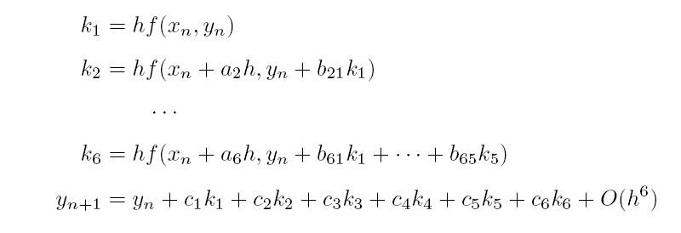
2nd method: More elegant and faster cheaper better : Adaptive Runge Kutta 5
Fehlberg method for Runge Kutta
Felhberg studied RK5. It requires 6 calls to the derivative
The RK5 is as follows
The result is accurate to order 5

Slide 88
But Fehlberg shows that other combination coefficients gives a result with 4th order accuraty (with different coefficients, but same evaluations of derivative)
5th order
4th order
SO: In calculating the same quantities k1 to k6, we can have two different assessments of the result:
Y_{not} to about 5
Y *_{not}to order 4
=> ABS (Y *_{not}⁻Y_{not}) Is an estimate of the error in the order of 5

Slide 89
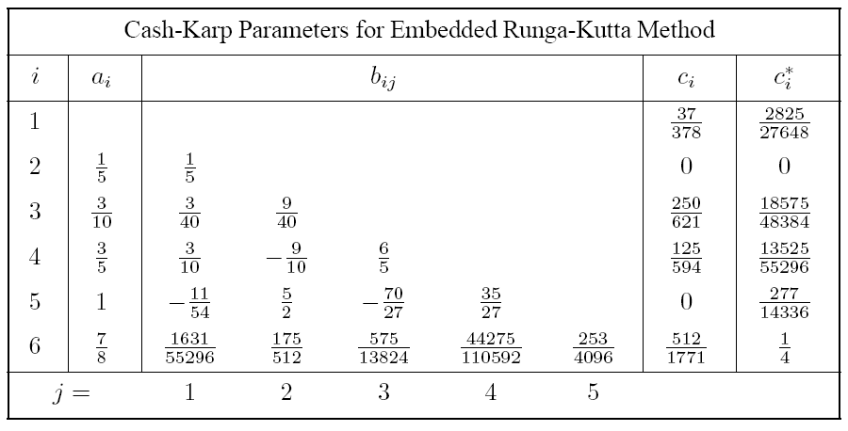
Coefficients table for RK5
5th order
4th order

Slide 90
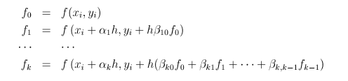
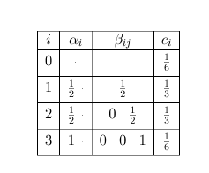
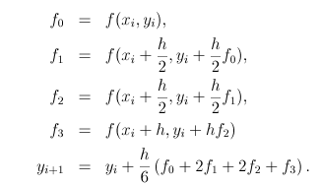
We can use an array of coefficients also for the RK4
RK4

Slide 91
Suppose we have two different estimates of the result,
X_{n} and X*_{n}
The error Δ ~ || X *_{n}- X_{not}|| ∝dt⁵
We seek the new timestep so that Δ₀ / Δ =Precision required
So we have (dt’ / dt)⁵= Δ₀ / Δ dt’=new time step
=> dt’/dt = (Δ₀/ Δ)^{1/5}
This serves two purposes:
1- If the error is too large time step decreases
2- If the error is too small time step increases => saves time!

Slide 92
A typical adaptive RK5. scheme
Evaluates Y_{n} (5th order) and Y *_{n} (4th order)
Calculate Δ=Abs(Y_{n}- Y *_{n}) (for exameple)= the error control parameter
Calculate dt ‘
if dt >dt’ : Reject solution. Replace dt by dt’ and go back to 1
If dt <dt’ :accept sol. Y_{n} is the next U_{n}, Replace dt by dt’. Go to next step
5. Return to 1 (the next time step)
CAUTION: If you work with adaptive time step you must have an additional
Control parameter (like energy) to make sure the calculation is globally valid

Slide 93
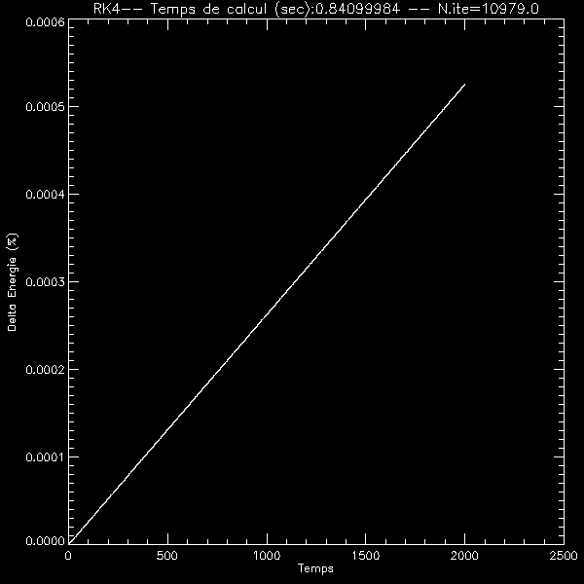
Example: RK4 Vs. Adaptive RK5. Problem of the planet
RK4 Energy
Dt = 0.2
Adaptive Energy RK5
The error on E increases 2 times slower
With comparable computing time

Slide 94
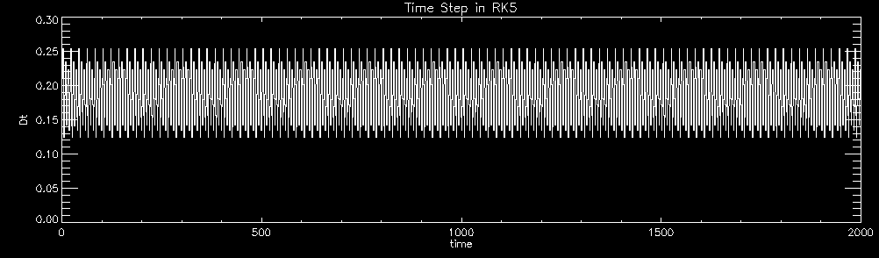
Here is the time step of the Adaptive RK5
dt decreases as the planet accelerates (perihelion)
dt increases when the planet decelerates (Aphelion)

Slide 95
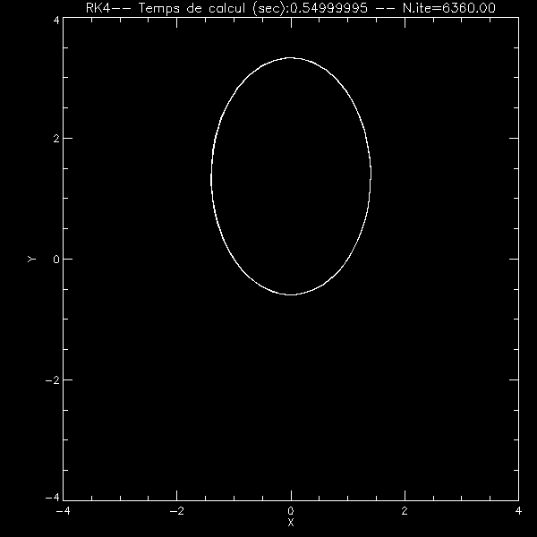
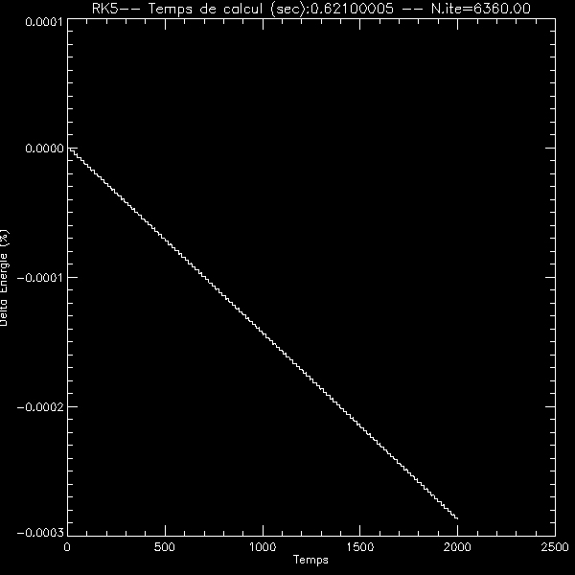
Consider a VERY elongated orbit (difficult to integrate)
adaptive RK5
Var .energy

Slide 96
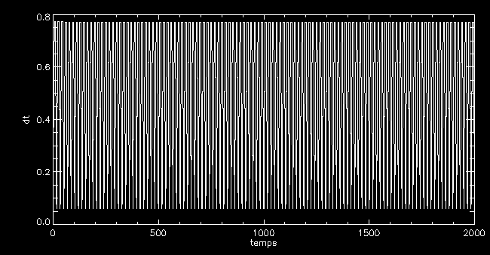
Evolution of adaptive RK5 time step:
The time step adapts to the orbit.
Initial time step: 0.5

Slide 97
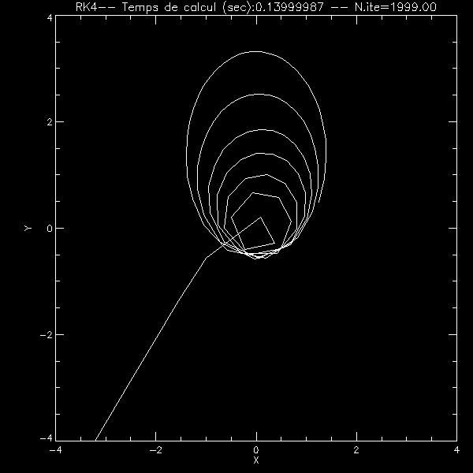
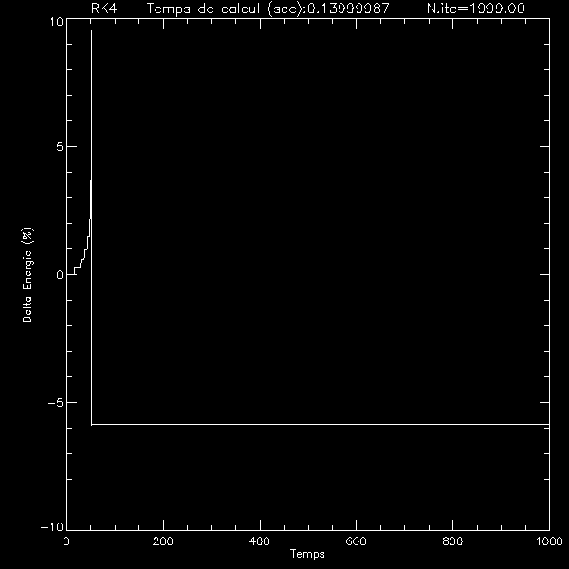
RK4 DT = 0.5, same initial conditions
Energy ....
Hmmm ... ..

Slide 98
CONCLUSION
Choosing the solver depends on the problem
(Single Issue? Stiff Problem? Etc ...)
2. A high order solver does not mean ALWAYS higher accuracy
3. Sometimes a Implicit solver can simplify your life and increase accuracy
Do not believe the result of a solver too rapidly !!!
You must always keep a critical viewpoint in front of a numerical integration
You must define control parameters
4. Always check what is done Compare analytical solutions, control energy if possible
5. Use adaptive time-steps with * lots * of precautions

